Slide 1

Mode Choice in R
Raoul Rothfeld (raoul.rothfeld@tum.de)
Based on material from Hema Sharanya Rayaprolu
07 January 2019

Slide 2
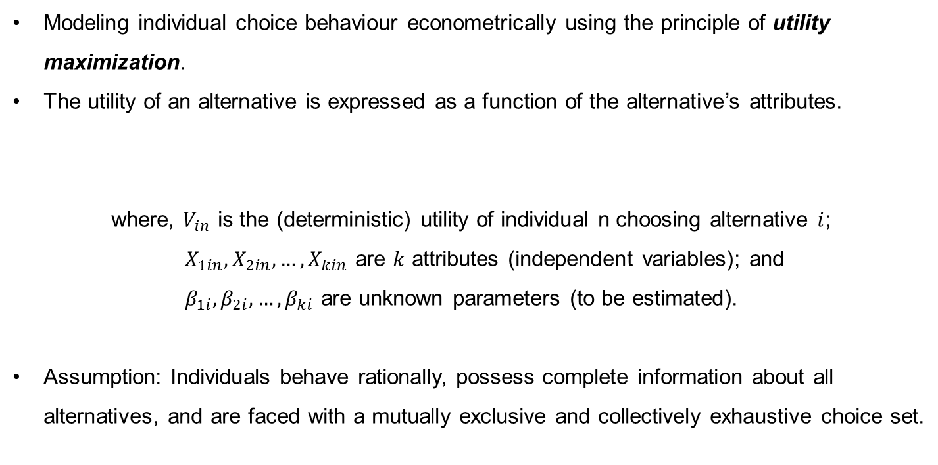

Discrete Choice Modeling
Modeling individual choice behaviour econometrically using the principle of utility maximization.
The utility of an alternative is expressed as a function of the alternative’s attributes.
where, $V_{in}$ is the (deterministic) utility of individual n choosing alternative $i$;
$X_{1in}, X_{2in}, …, X_{kin}$ are $k$ attributes (independent variables); and
$β_{1i}, β_{2i}, …, β_{ki}$ are unknown parameters (to be estimated).
Assumption: Individuals behave rationally, possess complete information about all alternatives, and are faced with a mutually exclusive and collectively exhaustive choice set.
$$V_{in}= β_{1i}X_{1in}+ β_{2i}X_{2in}+…+ β_{ki}X_{kin}$$
Notes:
Utility is the index of attractiveness of an alternative

Slide 3

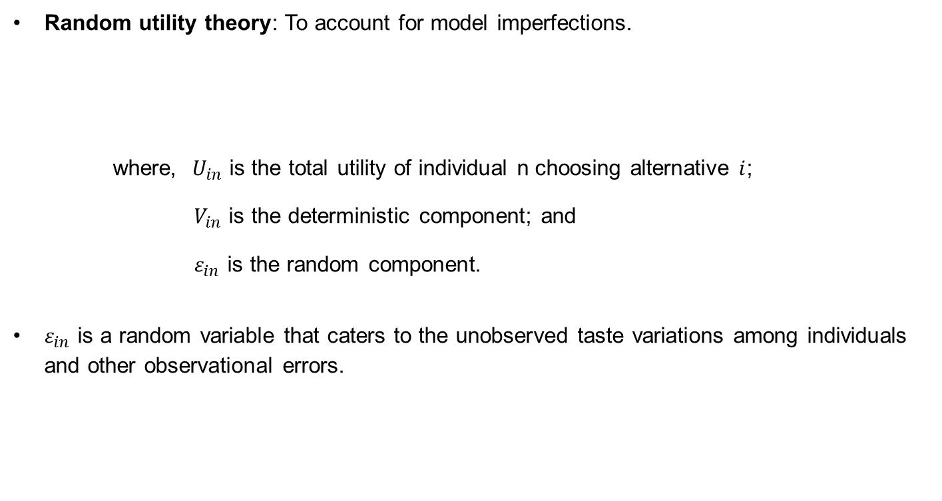
Discrete Choice Modeling
Random utility theory: To account for model imperfections.
where, $U_{in}$ is the total utility of individual n choosing alternative $i$;
$V_{in}$ is the deterministic component; and
$ε_{in}$ is the random component.
$ε_{in}$ is a random variable that caters to the unobserved taste variations among individuals and other observational errors.
$$U_{in}= V_{in}+ ε_{in}$$

Slide 4
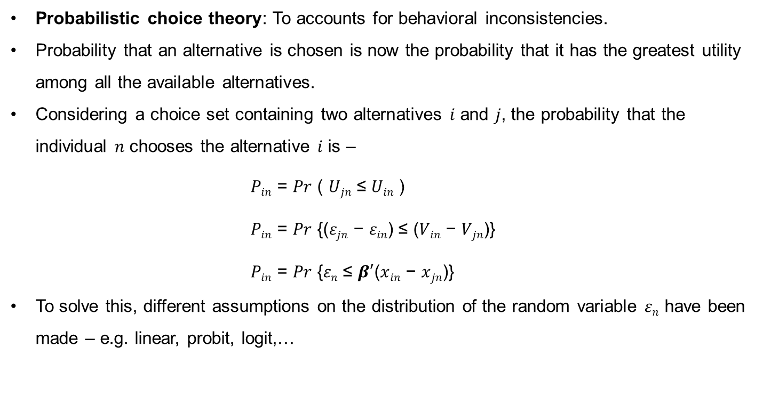
Discrete Choice Modeling
Probabilistic choice theory: To accounts for behavioral inconsistencies.
Probability that an alternative is chosen is now the probability that it has the greatest utility among all the available alternatives.
Considering a choice set containing two alternatives 𝑖 and 𝑗, the probability that the individual 𝑛 chooses the alternative 𝑖 is –
𝑃_{𝑖𝑛} = $Pr$ ( 𝑈_{𝑗𝑛} ≤ 𝑈_{𝑖𝑛} )
𝑃_{𝑖𝑛} = $Pr$ {(𝜀_{𝑗𝑛} − 𝜀_{𝑖𝑛}) ≤ (𝑉_{𝑖𝑛} − 𝑉_{𝑗𝑛})}
𝑃_{𝑖𝑛} = $Pr$ {𝜀_{𝑛} ≤ $β′$($x$_{𝑖𝑛} − $x$_{𝑗𝑛})}
To solve this, different assumptions on the distribution of the random variable 𝜀_{𝑛} have been made – e.g. linear, probit, logit,…

Slide 5
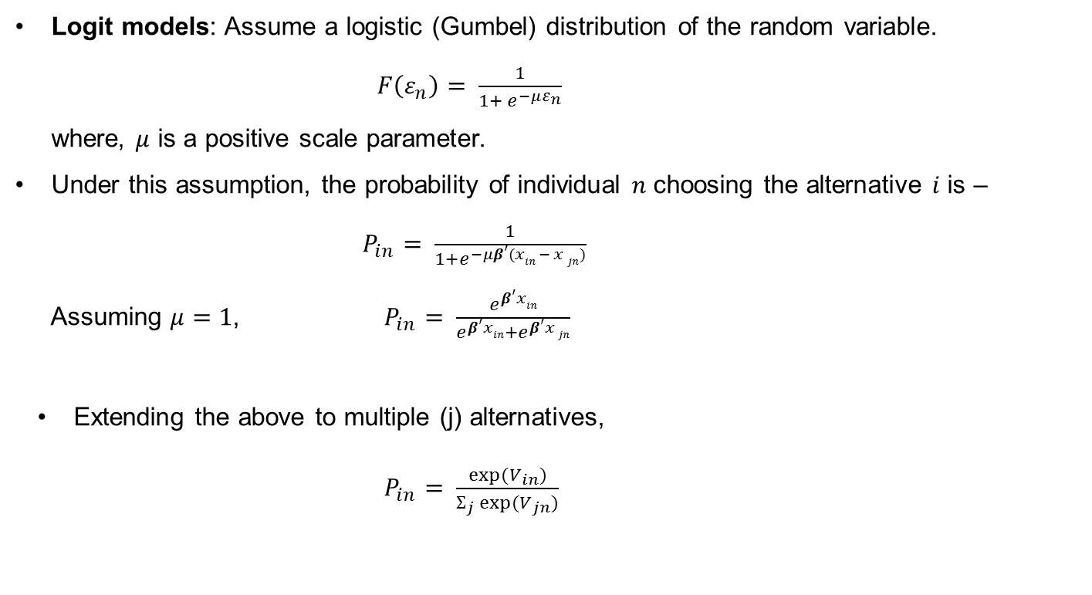
Discrete Choice Modeling
Logit models: Assume a logistic (Gumbel) distribution of the random variable.
$F\left(ε_{n}\right)= \frac{1}{1+ e^{−με_{n}}}$
where, $μ$ is a positive scale parameter.
Under this assumption, the probability of individual 𝑛 choosing the alternative 𝑖 is – $P_{in}= \frac{1}{1+e^{−μβ′(xin − x jn)}}$
Assuming $μ=1$, $P_{in}= \frac{e^{β′xin}}{e^{β′xin}+e^{β′x jn}}$
Extending the above to multiple (j) alternatives,
$P_{in}= \frac{exp(V_{in})}{Ʃ_{j} exp(V_{jn})}$
Notes:
Linear – simplistic
Probit – assumes normal distribution => choice probabilities are never zero or one; computationally cumbersome.
Logit – probit like, but analytically convenient; has a closed form

Slide 6
Discrete Choice Modeling
Multinomial logit (MNL) models: Assume all alternatives are mutually exclusive (and exhaustive.
Nested logit models: Allow for correlation between alternatives.
Group correlated alternatives into separate nests.
Mode
Walk
Bicycle
Transit
Auto
Mode
Non-motorized
Motorized
Walk
Bicycle
Transit
Auto
Notes:
Cross elasticity: Impact of % change in one mode’s attributes on choice probabilities of other modes. (vs. direct elasticity)

Slide 7
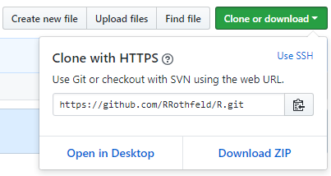
Material for Today’s Class
https://github.com/RRothfeld/R
1
2

Slide 8
Estimation in R
Using the mlogit package (though, there are alternatives)
Model specification:
Choice alternatives (modes)
Independent variables
Data formats: wide (one row for each choice observation) or long (one row for each alternative of each observation)
Formula:
Part 1: Alternative-specific variables
Part 2: Individual-specific variables
Part 3: Alternative-specific variables with coefficients varying across alternatives
Choice ~ Part 1 | Part 2 | Part 3

Slide 9
References
Ben-Akiva, M., & Lerman, S. R. (1985). Discrete Choice Analysis: Theory and Application to Travel Demand. Massachusetts: MIT Press.
Croissant, Y. (2011). Estimation of multinomial logit models in R: The mlogit Packages. Retrieved from Universit´e de la R´eunion website: https://cran.r-project.org/web/packages/mlogit/vignettes/mlogit.pdf
Ortúzar, J. d. D., & Willumsen, L. G. (2011). Modelling Transport (Fourth Edition). Chichester, West Sussex, United Kingdom: John Wiley & Sons, Ltd.
Viton, P. A. (2015). Discrete-Choice Logit Models with R. Retrieved from http://facweb.knowlton.ohio-state.edu/pviton/courses2/crp5700/5700-mlogit.pdf

